Slide 1
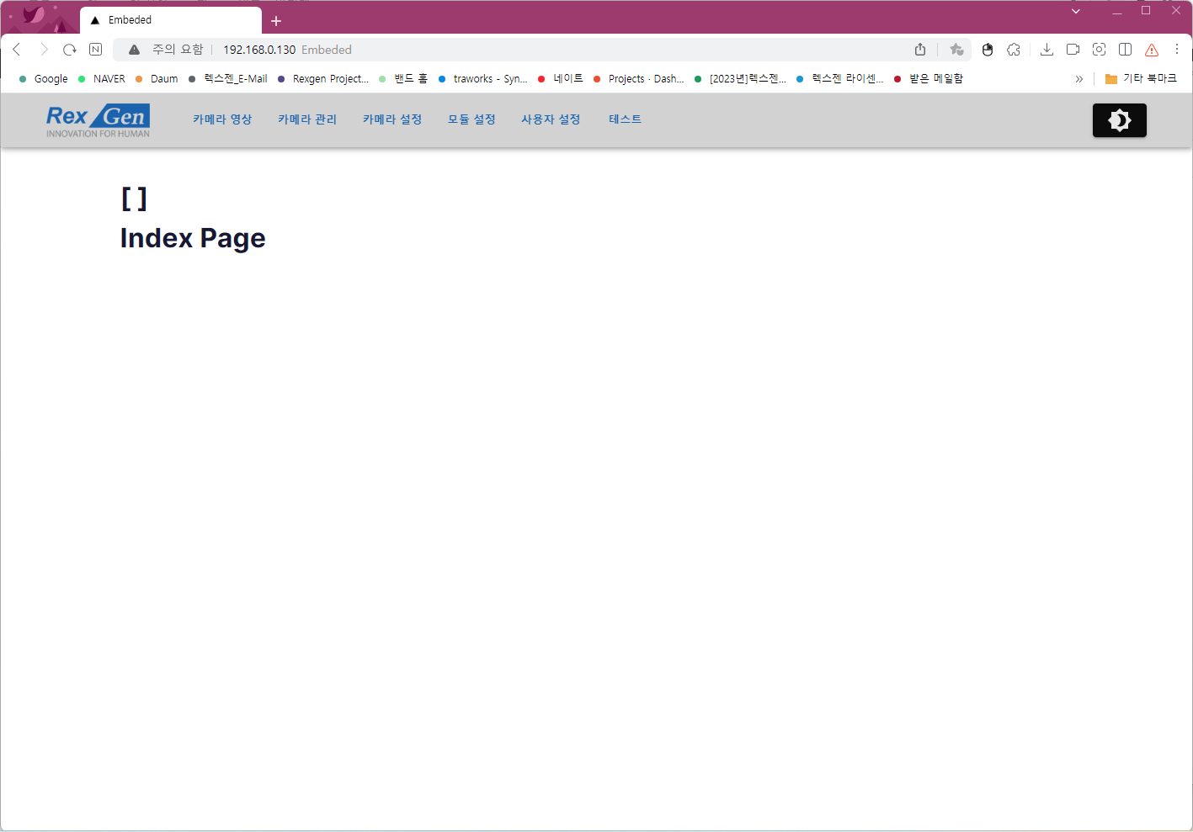

Slide 2











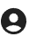
import SmartDisplaySharpIcon from '@mui/icons-material/SmartDisplaySharp';
import VideocamSharpIcon from '@mui/icons-material/VideocamSharp';
import DeveloperBoardIcon from '@mui/icons-material/DeveloperBoard';
import SettingsSharpIcon from '@mui/icons-material/SettingsSharp';
import GroupSharpIcon from '@mui/icons-material/GroupSharp';
import AccountCircleSharpIcon from '@mui/icons-material/AccountCircleSharp';

Slide 3
영상보기
카메라
설정
모듈
사용자
import SmartDisplaySharpIcon from '@mui/icons-material/SmartDisplaySharp';
import VideocamSharpIcon from '@mui/icons-material/VideocamSharp';
import DeveloperBoardIcon from '@mui/icons-material/DeveloperBoard';
import SettingsSharpIcon from '@mui/icons-material/SettingsSharp';
import GroupSharpIcon from '@mui/icons-material/GroupSharp';
import AccountCircleSharpIcon from '@mui/icons-material/AccountCircleSharp';

Slide 4

영상보기
카메라
설정
모듈
사용자
import DeveloperBoardIcon from '@mui/icons-material/DeveloperBoard';
import ControlCameraSharpIcon from '@mui/icons-material/ControlCameraSharp';
import VideocamSharpIcon from '@mui/icons-material/VideocamSharp';
import SettingsSharpIcon from '@mui/icons-material/SettingsSharp';
import SmartDisplaySharpIcon from '@mui/icons-material/SmartDisplaySharp';
import GroupSharpIcon from '@mui/icons-material/GroupSharp';
import AccountCircleSharpIcon from '@mui/icons-material/AccountCircleSharp';

Slide 5
영상보기
카메라
설정
모듈
사용자
import DeveloperBoardIcon from '@mui/icons-material/DeveloperBoard';
import ControlCameraSharpIcon from '@mui/icons-material/ControlCameraSharp';
import VideocamSharpIcon from '@mui/icons-material/VideocamSharp';
import SettingsSharpIcon from '@mui/icons-material/SettingsSharp';
import SmartDisplaySharpIcon from '@mui/icons-material/SmartDisplaySharp';
import GroupSharpIcon from '@mui/icons-material/GroupSharp';
import AccountCircleSharpIcon from '@mui/icons-material/AccountCircleSharp';

Slide 6
영상보기
카메라
설정
모듈
사용자
import DeveloperBoardIcon from '@mui/icons-material/DeveloperBoard';
import ControlCameraSharpIcon from '@mui/icons-material/ControlCameraSharp';
import VideocamSharpIcon from '@mui/icons-material/VideocamSharp';
import SettingsSharpIcon from '@mui/icons-material/SettingsSharp';
import SmartDisplaySharpIcon from '@mui/icons-material/SmartDisplaySharp';
import GroupSharpIcon from '@mui/icons-material/GroupSharp';
import AccountCircleSharpIcon from '@mui/icons-material/AccountCircleSharp';

